Slide 1
POLLUTION

Slide 2
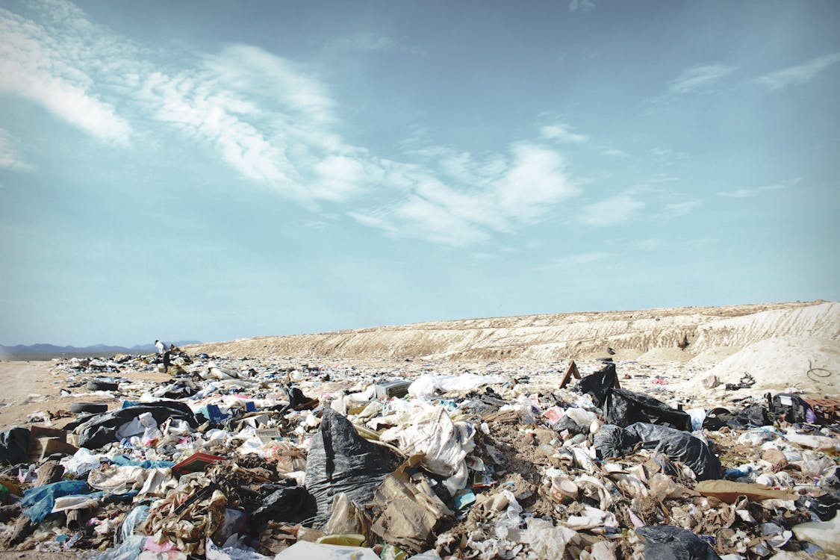

Slide 3
OVERVIEW
Definition of Pollution
Types of Pollution
Air Pollution
Water Pollution
Noise Pollution
Land Pollution
Radio Active Pollution

Slide 4
Definition of pollution
When harmful substances contaminate environment it is called pollution.
Pollution refers to the very bad condition of environment in terms of
quantity and quality.

Slide 5
Types of pollution
Air pollution
Water pollution
Noise pollution
Land pollution
Radio active pollution

Slide 6
Air pollution
What is atmosphere
Atmosphere is the life blanket of earth.
Therefore essential that we know more about the atmosphere and the ways in which it is polluted.
Air is considered safe when it contains no harmful dust and gases.

Slide 7
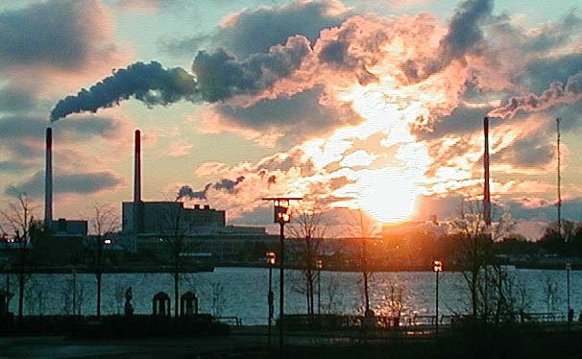
AIR POLLUTION PICTURE
This Photo by Unknown Author is licensed under CC BY

Slide 8
Water pollution
Any physical (temperature, oxygen), chemical (mercury), or biological (disease, sewage) change to water that adversely affects its us by alive beings.

Slide 9
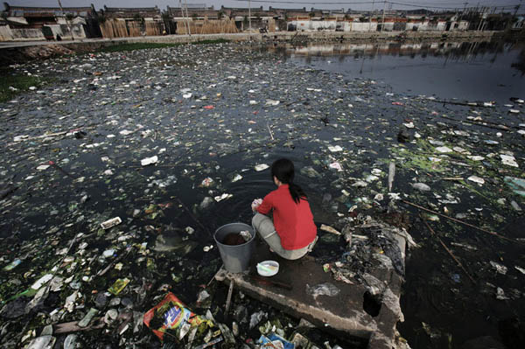
WATER POLLUTION PICTURE
This Photo by Unknown Author is licensed under CC BY-NC-ND

Slide 10
Noise pollution
Noise can we simply defined as unwanted sound.
The sound is pleasant or not depends upon its loudness, duration, rhythm and the mood of the person.
Noise pollution not only result in irritation and anger.
Noise levels: Decibels (DB)
Intensity
Frequency
Periods of exposure and
Duration

Slide 11
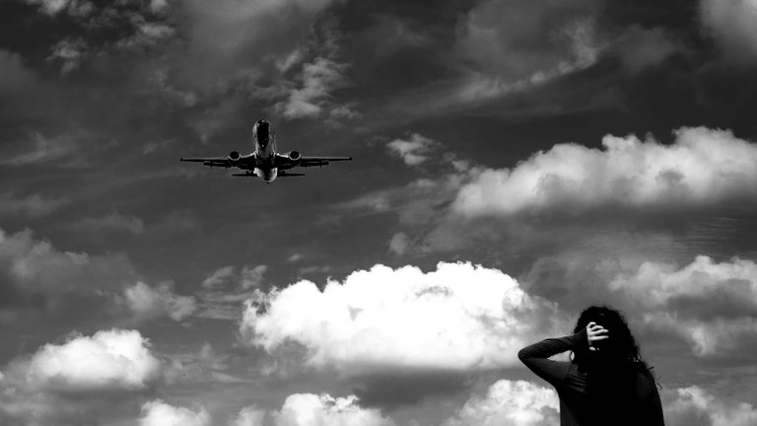
NOISE POLLUTION PICTURE
This Photo by Unknown Author is licensed under CC BY

Slide 12
LAND POLLUTION
One fourth of area is covered by land.
Land is the earth which is occupied by people for shelter, occupation etc.

Slide 13
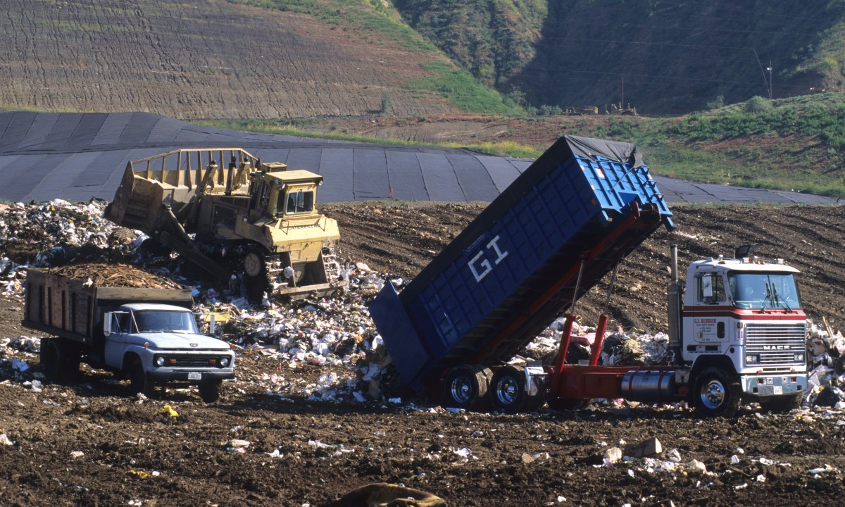
LAND POLLUTION PICTURE

Slide 14
Radio active pollution
Despite the advantage of nuclear as a clean energy, the big concern is the resulted from nuclear reaction, which is the form of pollution called radio actively.
Radiation (laser-Rays) will from Radioactive pollution.

Slide 15
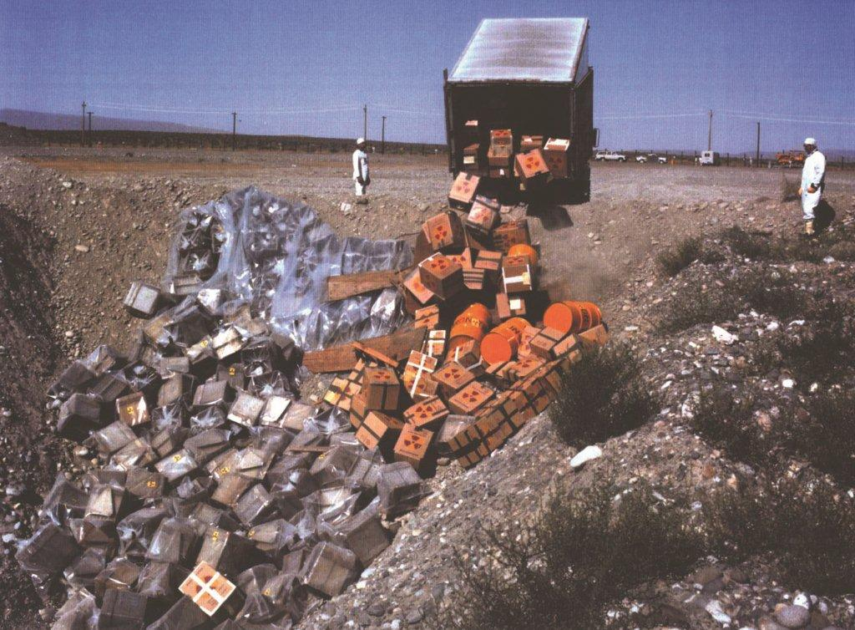
RADIO ACTIVE POLLUTION
This Photo by Unknown Author is licensed under CC BY

